Slide 1
BT 205: Cell & Molecular Biology
-Prof. Siddhartha Sankar Ghosh

Slide 2

The gene cluster and promoter, plus additional sequences that function together in regulation, are called an operon.

Slide 3
Two types of negative regulation are illustrated

Slide 4
Two types of positive regulation is mediated by gene activators

Slide 5
Repressors and Negative Control of Transcription
Transcription can be regulated at the stages of both initiation and elongation, but most transcriptional regulation in bacteria operates at the level of initiation.
The pioneering studies of gene regulation in E. coli were carried out by Francois Jacob and Jacques Monod in the 1950s.
These investigators and their colleagues analyzed the expression of enzymes involved in the metabolism of lactose, which can be used as a source of carbon and energy via cleavage to glucose and galactose.

Slide 6

Lac operon

Slide 8
Lactose metabolism in E. coli.
Uptake and metabolism of lactose require the activities of galactoside (lactose) permease and β- galactosidase.
Conversion of lactose to allolactose by transglycosylation is a minor reaction also catalyzed by β-galactosidase

Slide 9
Negative control of the lac operon

Slide 10
Negative control of the lac operon
The i gene encodes a repressor which, in the absence of lactose (top), binds to the operator (o) and interferes with the binding of RNA polymerase to the promoter, blocking transcription of the three structural genes (z, β-galactosidase; y, permease; and a, transacetylase).
Lactose induces expression of the operon by binding to the repressor (bottom), which prevents the repressor from binding to the operator. P =promoter; Pol= polymerase.

Slide 12


Slide 13
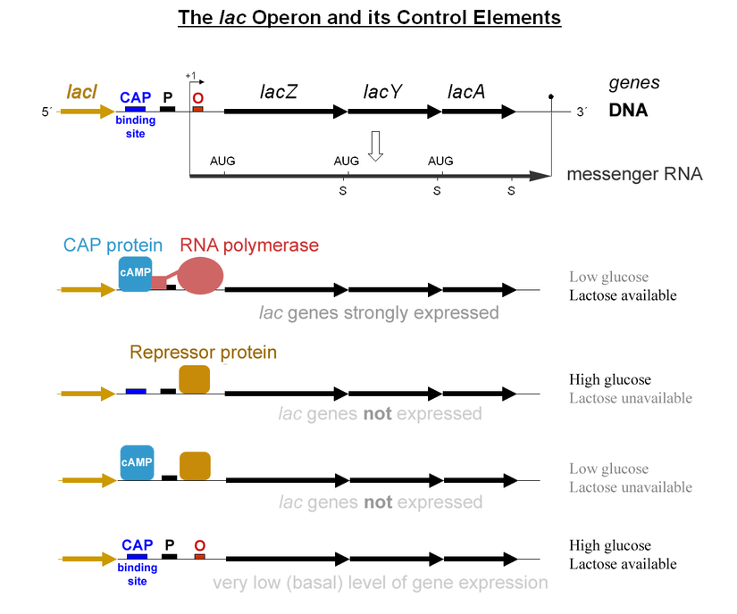

Slide 14
Positive control of the lac operon by glucose:
Low levels of glucose activate adenylyl cyclase, which converts ATP to cyclic AMP (cAMP).
Cyclic AMP then binds to the catabolite activator protein (CAP) and stimulates its binding to regulatory sequences of various operons concerned with the metabolism of alternative sugars, such as lactose.
CAP interacts with the a subunit of RNA polymerase to facilitate the binding of polymerase to the promoter.

Slide 15
Regulation of β-galactosidase in diploid E. coli

Slide 16

The mating of two bacterial strains results in diploid cells that contain genes from both parents.
In these examples, it is assumed that the genes encoding β -galactosidase (the z genes) can be distinguished on the basis of structural gene mutations, designated
z¹ and z².
In an ;+/;- diploid, both structural genes are inducible; therefore ;+ is dominant over ;- and affects expression of z genes on both chromosomes.
In contrast, in an o^{c} I o⁺ diploid, the z gene linked to o^{c} is constitutively expressed, whereas that linked to o⁺ is inducible. Therefore o affects expression of only the adjacent z gene on the same chromosome.

Slide 17
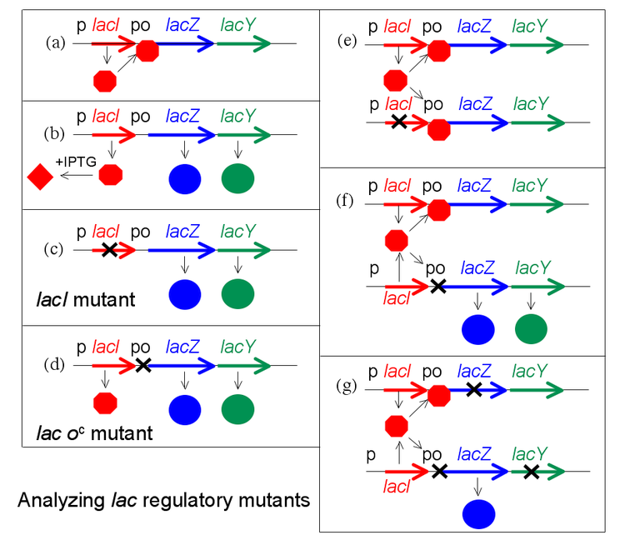

Slide 18
Q. Show synthesis of beta galactosidase, permease for the followings in presence and absence of IPTG and give brief reasons:
a) I⁺Z⁻Y⁺/F⁻I⁻Z⁺ Y⁺
O⁺Z⁻Y⁺/F-O^{c}Z⁺Y⁻
Answer:
a) Z +, +, Y +, +
b) Z+,+ ,Y -, +

Slide 19
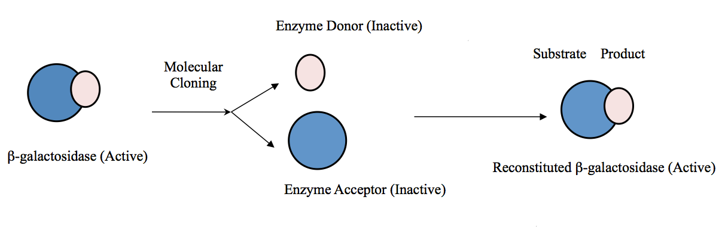
β-galactosidase α-Complementation

Slide 20
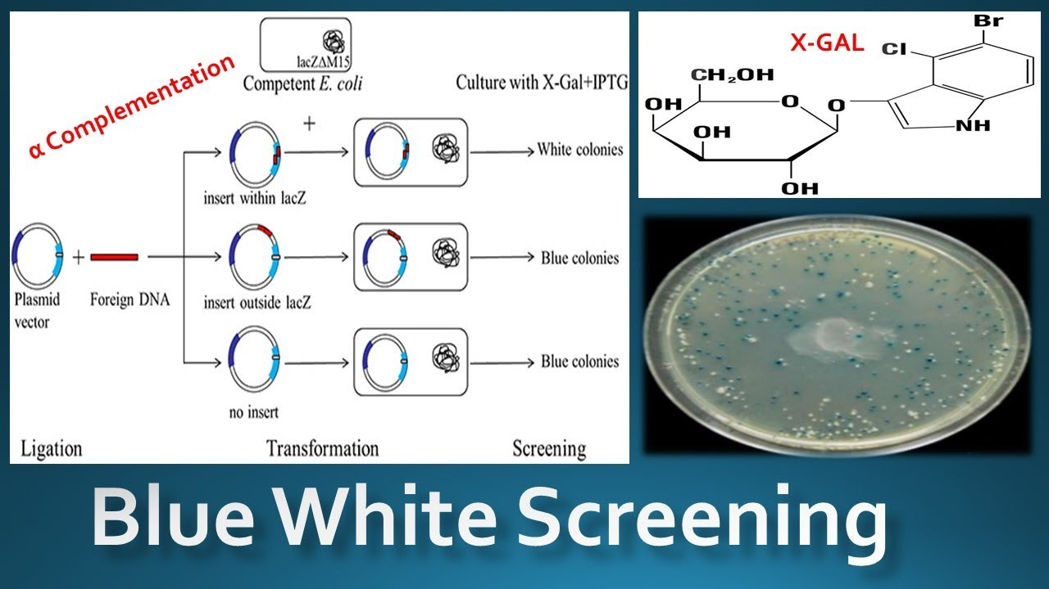

Slide 21
THANK YOU

